Slide 1


Renewable Energy Vehicles’ Graphical User Interface
Redesign of GUI
&
Road Testing of Holden Volt
Marcus Pham 20495924
Notes:
Hi, Im Marcus Pham and my project deals with improving the instrumentation in the 2 REV Car’s, the Hyundai Getz (REV Eco) and the Lotus Elise (REV Racer). Vehiclular instrumentation is the first point of contact from human to machine and hence is critically important to have a well designed user interface to enable safe and functional driving. This is particularly important in electric vehicles due to the need to be able to constantly monitor statistics from the vehicle, from speed to battery condition and distance remaining. Though the cars have been on the road since 2008, the instrumentation has not yet been implemented perfectly to suit the needs of drivers.

Slide 2
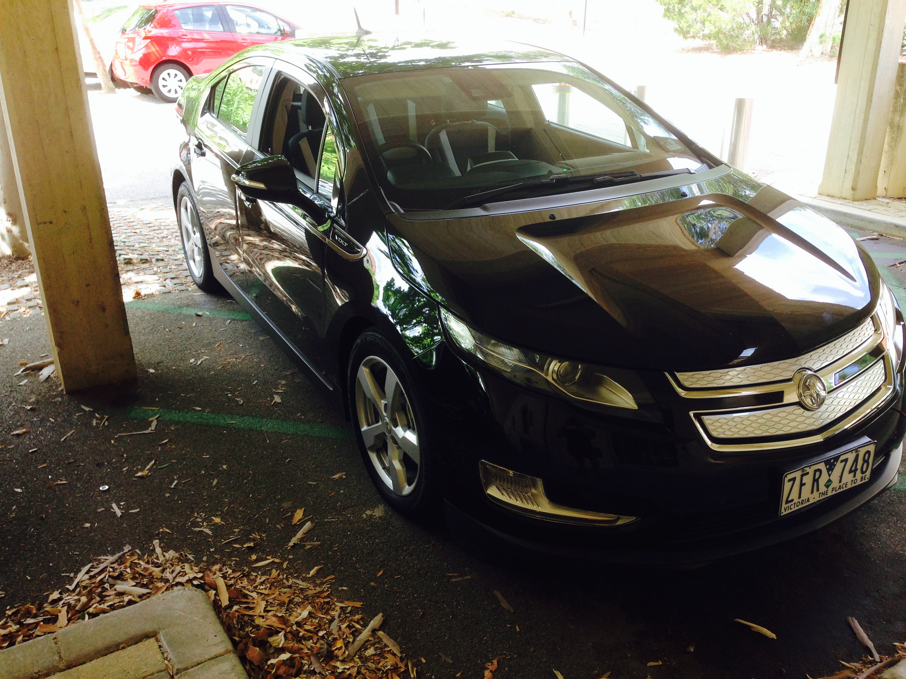

Road Testing of Holden Volt
Worked alongside Murdoch University and Holden Australia & Shacks Holden Fremantle
Report to be published soon
Compare with REV Eco
Notes:
As a side task, I was also asked by Prof. Thomas Braunl to road test a mass produced, full electric vehicle, the Holden/Chevrolet Volt. This was done at the beginning of the year, with Murdoch University and final aims are to publish the report and display results to compare with the factory given statistics of the car.

Slide 3
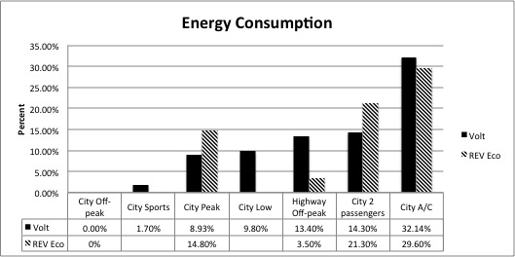
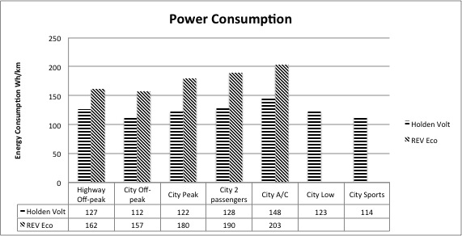
Results
30km Test Track – UWA to Fremantle
Improvements in comparison with REV Eco
Increase in usage evident under heavy loads and air-conditioning
Surprising results – Low and Sports Mode
Notes:
A series of tests were done to observe the differences in energy usage under different conditions. Each test was done 3 times by UWA on an approximately 30km test track from UWA to Fremantle and back. Results were compared with the REV Eco, clearly showing the improvements in efficiency by Holden compared to the lighter electric converted vehicle, such as regenerative braking.
Results clearly show the increases in usage with extra weight and under the heavy load of airconditioning. Surprising results are the increase in usage when driving in Low in comparison with Drive as well as the relatively small increase in energy use when using Sports Mode. The results are in the process of finalising and publishing.

Slide 4
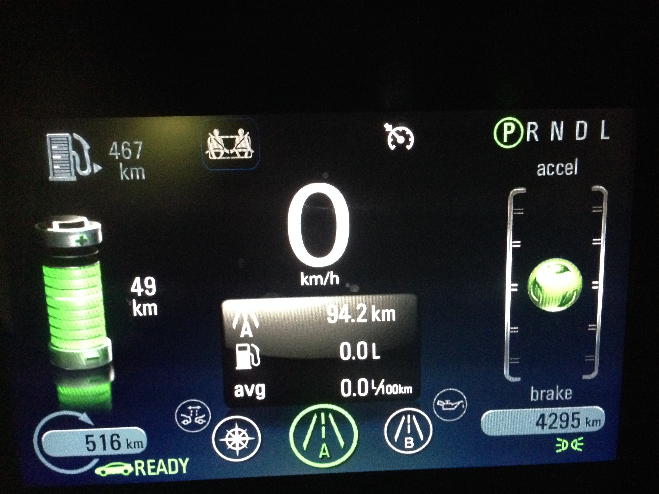
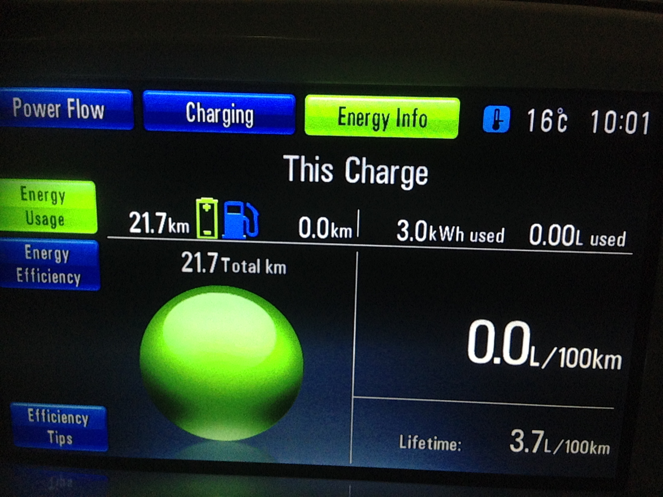
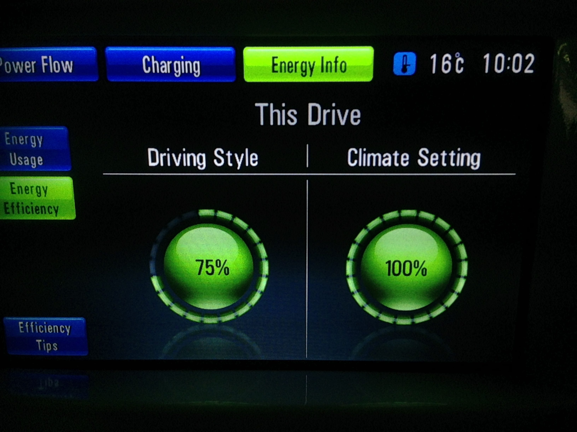
Holden Volt User Interface
Simple Layout
Display of charge used
Efficiency Ball
Efficiency rating
Notes:
An additional bonus with the road testing fo the Volt is that I was given to opportunity to see in action a user interface in currrently mass produced electric vehicles. This enabled me to take some ideas and implement the into the REV vehicles. The Volt, like the 2 REV vehicles, have 2 displays to provide information to the driver. One for drive statistics and the other to give secondary information, like GPS, music and charge information.
Whilst driving the Volt, some features that appealed to me were: the efficiency ball, the display of charge used, the relatively simple layout and the efficiency rating.
The Volt has an efficiency ball that moves up and down dependant on how hard a driver is accelerating of braking. Both extremes would cause increases in energy usage and would cause the ball to change from green to yellow to red indicating to the user that they were not driving as efficiently as possible. This in combination with a meter that displays how efficiently a driver is driving the vehicle, provides incentive to drive in a manner that would save the maximum amount of energy. Personally, after driving the car for hours a day on the same track, I know that the efficiency aids proved useful to encourage me to drive more efficiently, to get 100% driving efficiency.
This sparked the idea of implementing a few simple efficiency aids in both REV vehicles to increase and encourage more efficient driving techniques.

Slide 5
GUI Objectives
Improve the Graphical User Interface in both REV Racer and REV Eco
Add functionality missing due to transition to Raspberry Pi
Install Tachometer in both cars
An efficiency meter
Re-implement Engine Audio Replicating System (EARS)
Notes:
My key objectives that I put in place was the reimplementation of functionality lost due to a hardware change to a Raspberry Pi , Installation of a tachometer in both cars, an efficiency meter and finally to add the EARS

Slide 6
Process
Fix existing GUI in REV Eco
Install Tachometer in both cars
Install IO functionality
Modify GUI to induce efficient driving styles
Implement system in REV Racer
EARS
Notes:
As I begun the project, I realised that before I was able to begin any improvements on the system, the were many fixes that needed to be done. After that then I was to get the tachometer and IO functionality of the cars working whilst concurrently improving th GUI to encourage efficienct driving techniques. This was all to be completed in the REV Eco then modified slightly to install on the REV Racer.
Finally, the last task is to implement the EARS in both cars.

Slide 7
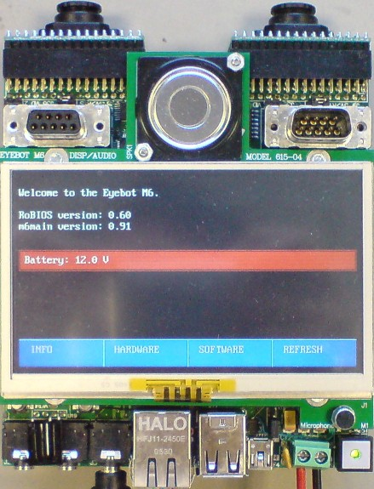
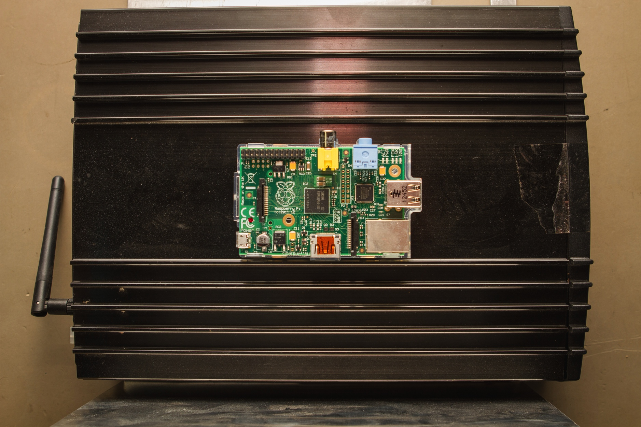
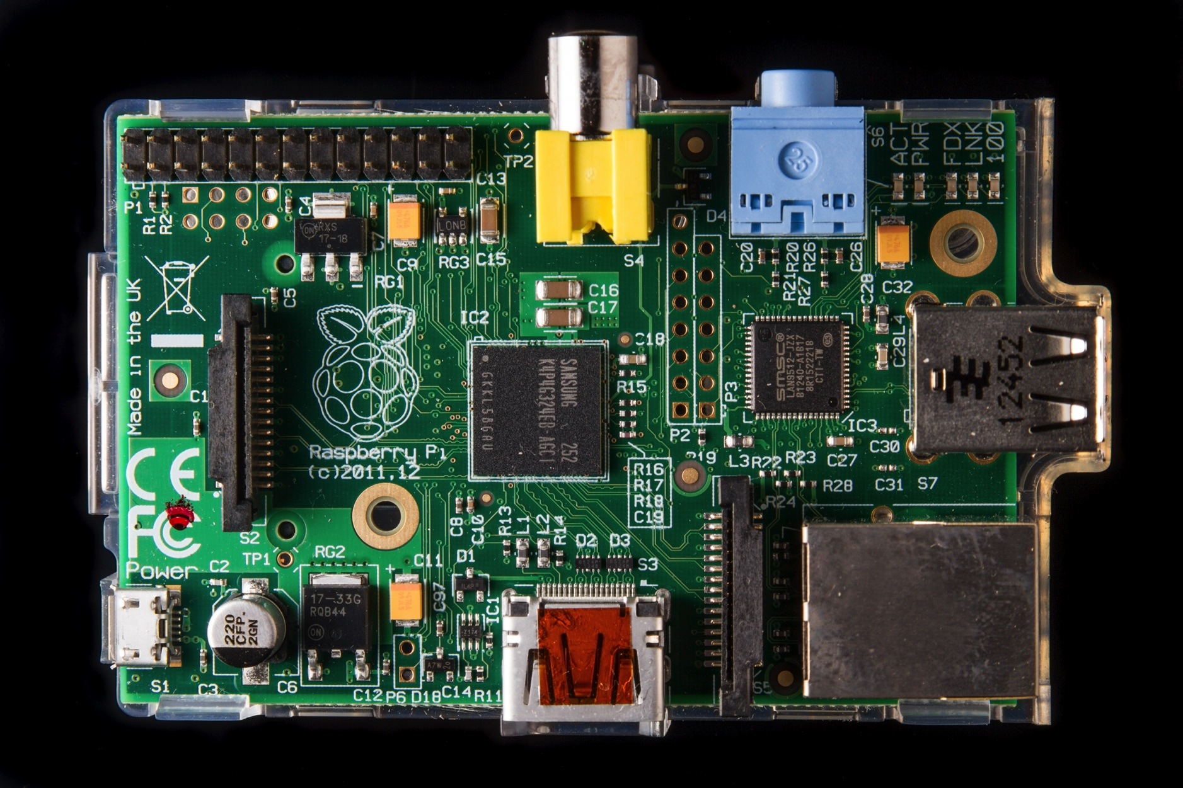
Previous systems
REV Eco (Getz)
Eyebot M6 embedded controller
BMS, GPS, GUI and logger
REV Racer (Lotus)
Dual Core Atom 1.6GHz PC
BMS, EARS, GPS
Notes:
The 2 Rev vehicles have recently had changes in the hardware used to run the GUI of the system. This was done in 2013 by Gabriel Feng, who did the project before me.
Prior to the change to Raspberry Pi, the cars contained expensive and bulky hardware, as well as the UI being different on both vehicles.

Slide 8

Previous GUI
Circular Layout
Small buttons
Not working IO/Tacho
Programmed in QT4/C++
Upgraded to QT5
Notes:
The Raspberry Pi provides a much more economic solution to running a GUI in the 2 vehicles. Additionally, changes to the GUI can be made easily and cheaply compared with previous implementation. Addtioanlly Rpi is compact and light, which makes it ideal for a vehicular application. Another benefit is the running noise, as there were numerous complaints about the PC in the Lotus being noisy due to the fans insie the PC.
The previous GUI was quite effective, yet still had its problems. Some issues with the GUI was that the buttons were too small which makes the touch screen difficult to use. It was also cumbersome to get to different pages due to the lack of buttons to get to another window from an opened page, it required users to return back to the home screen before being able to switch to the next. Also, the input outputs to the Rpi was not working and hence information from the car was not gained by the interface to readily inform the user.
Additionally, the software on the Raspberry Pi was outdated and required a full reformat to update the system to use QT5 which provided extra functionality.
The tachometer in both vehicles were not working either, which meant that the EARS could not be implemented.

Slide 9
Current System
Simpler, remove focus from background
Graphical view of efficiency
Efficiency gauge (%)
Economy
Notes:
The current GUI provides a simpler yet effective display to show drivers important information.
The background has been simplified, to remove focus from the background but rather on the information.
This is the home screen for the cars. The circular layout ahs been removed and large icons have been implemented which are easier to press. The Distance remaining and the Speed is more prominent, whiclst reducing th esize for driver name and time which are not as important.
Additons to the UI include the economy and the efficiency bar at the bottom. These are in line with aims to provide ways to encourage drivers to drive use more efficient driving techniques. Additionally, the colour scheme can be visible and reduces glare when driving.

Slide 10
Trip
Notes:
This is the newly implemented Trip tab. This tab displays statistics on the current trip as well and enabling users to start/ stop logging. Note the buttons at the bottom, enabling users to quicly change screens to the desired screen.

Slide 11
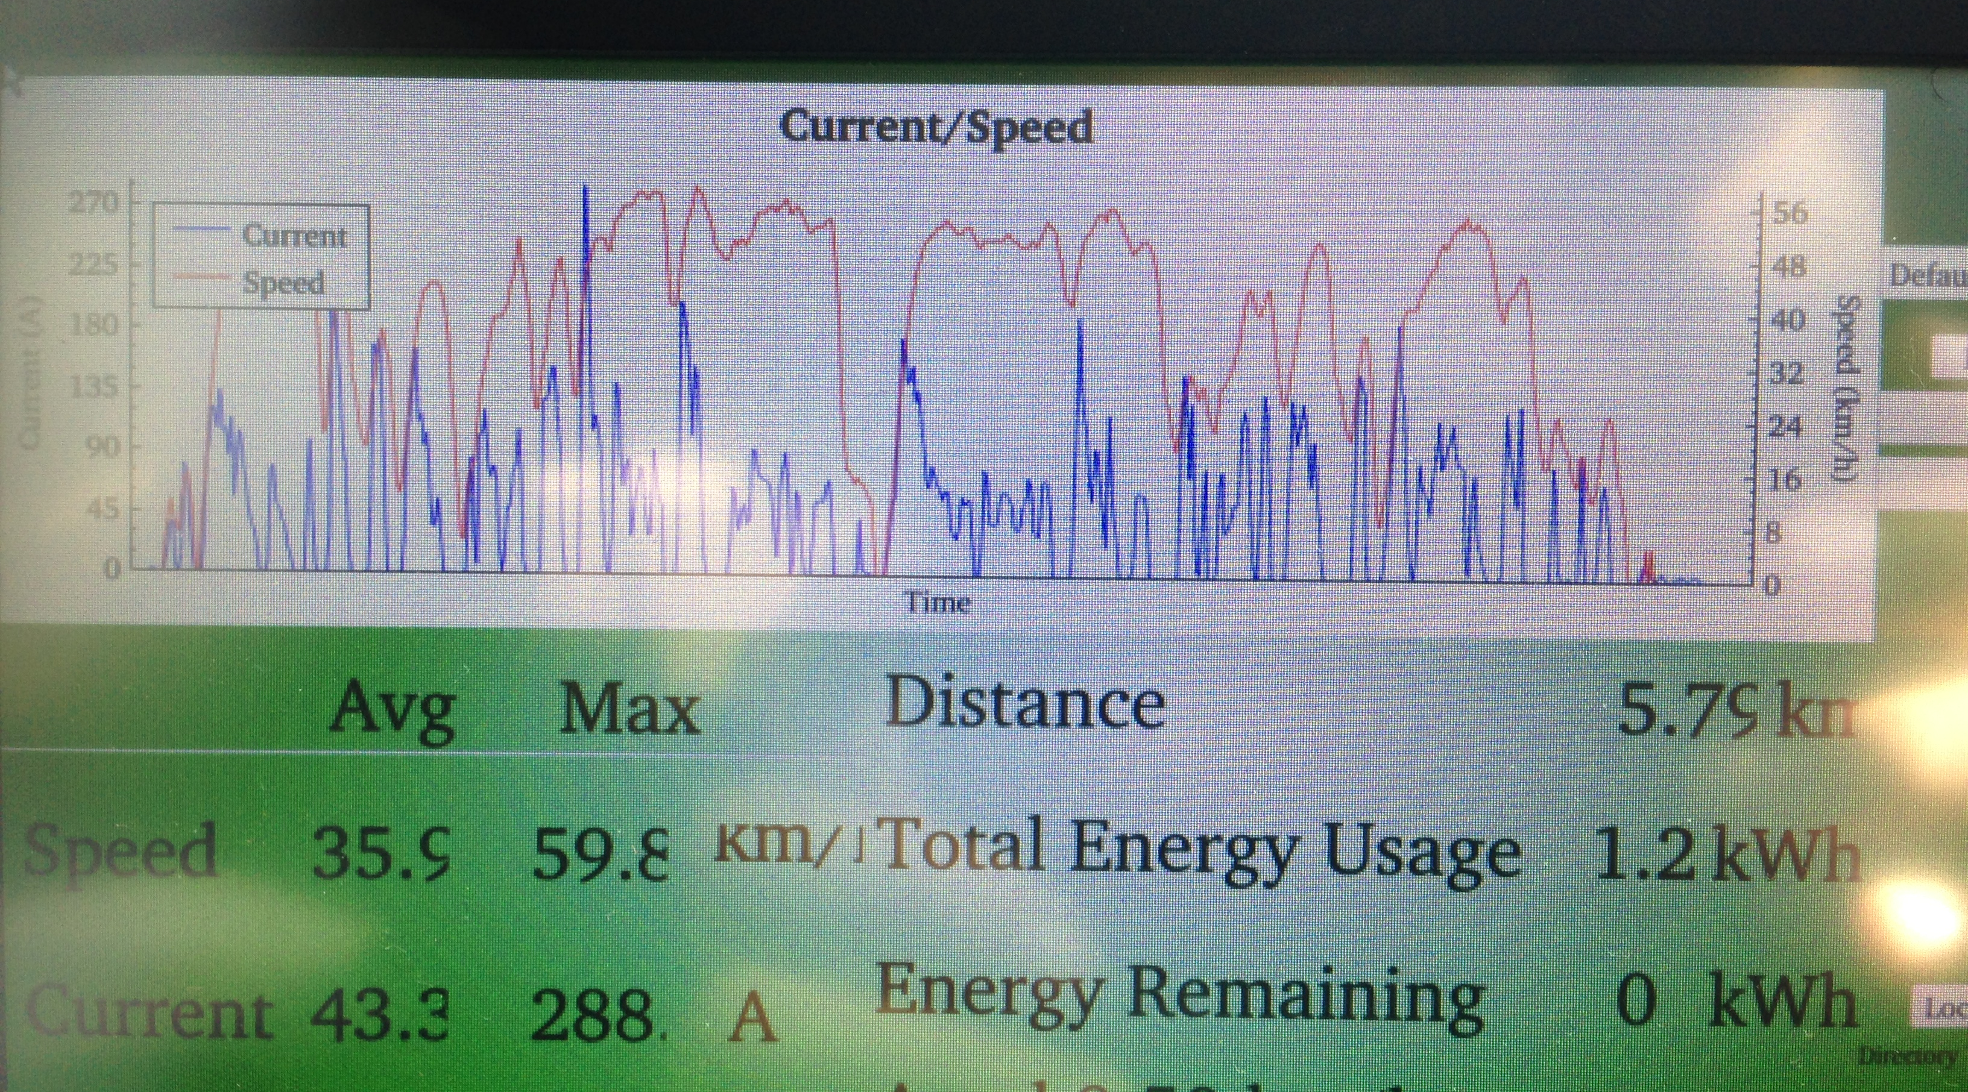
Efficiency
Notes:
You may have noticed the black box on the top right of the display. What that actually contains is a graph that shows users the the current draw vs the speed of the current trip. This graph is created in real time, showing users their driving habits. The blue line= current used whilst the red is the speed. The graph automatically rescales with changes in range. This is an actual drive around UWA that was done last week.
An additional graph and fill may be implemented in the upcoming weeks to show drivers what current ranges drivers should be attempting to stay within.

Slide 12
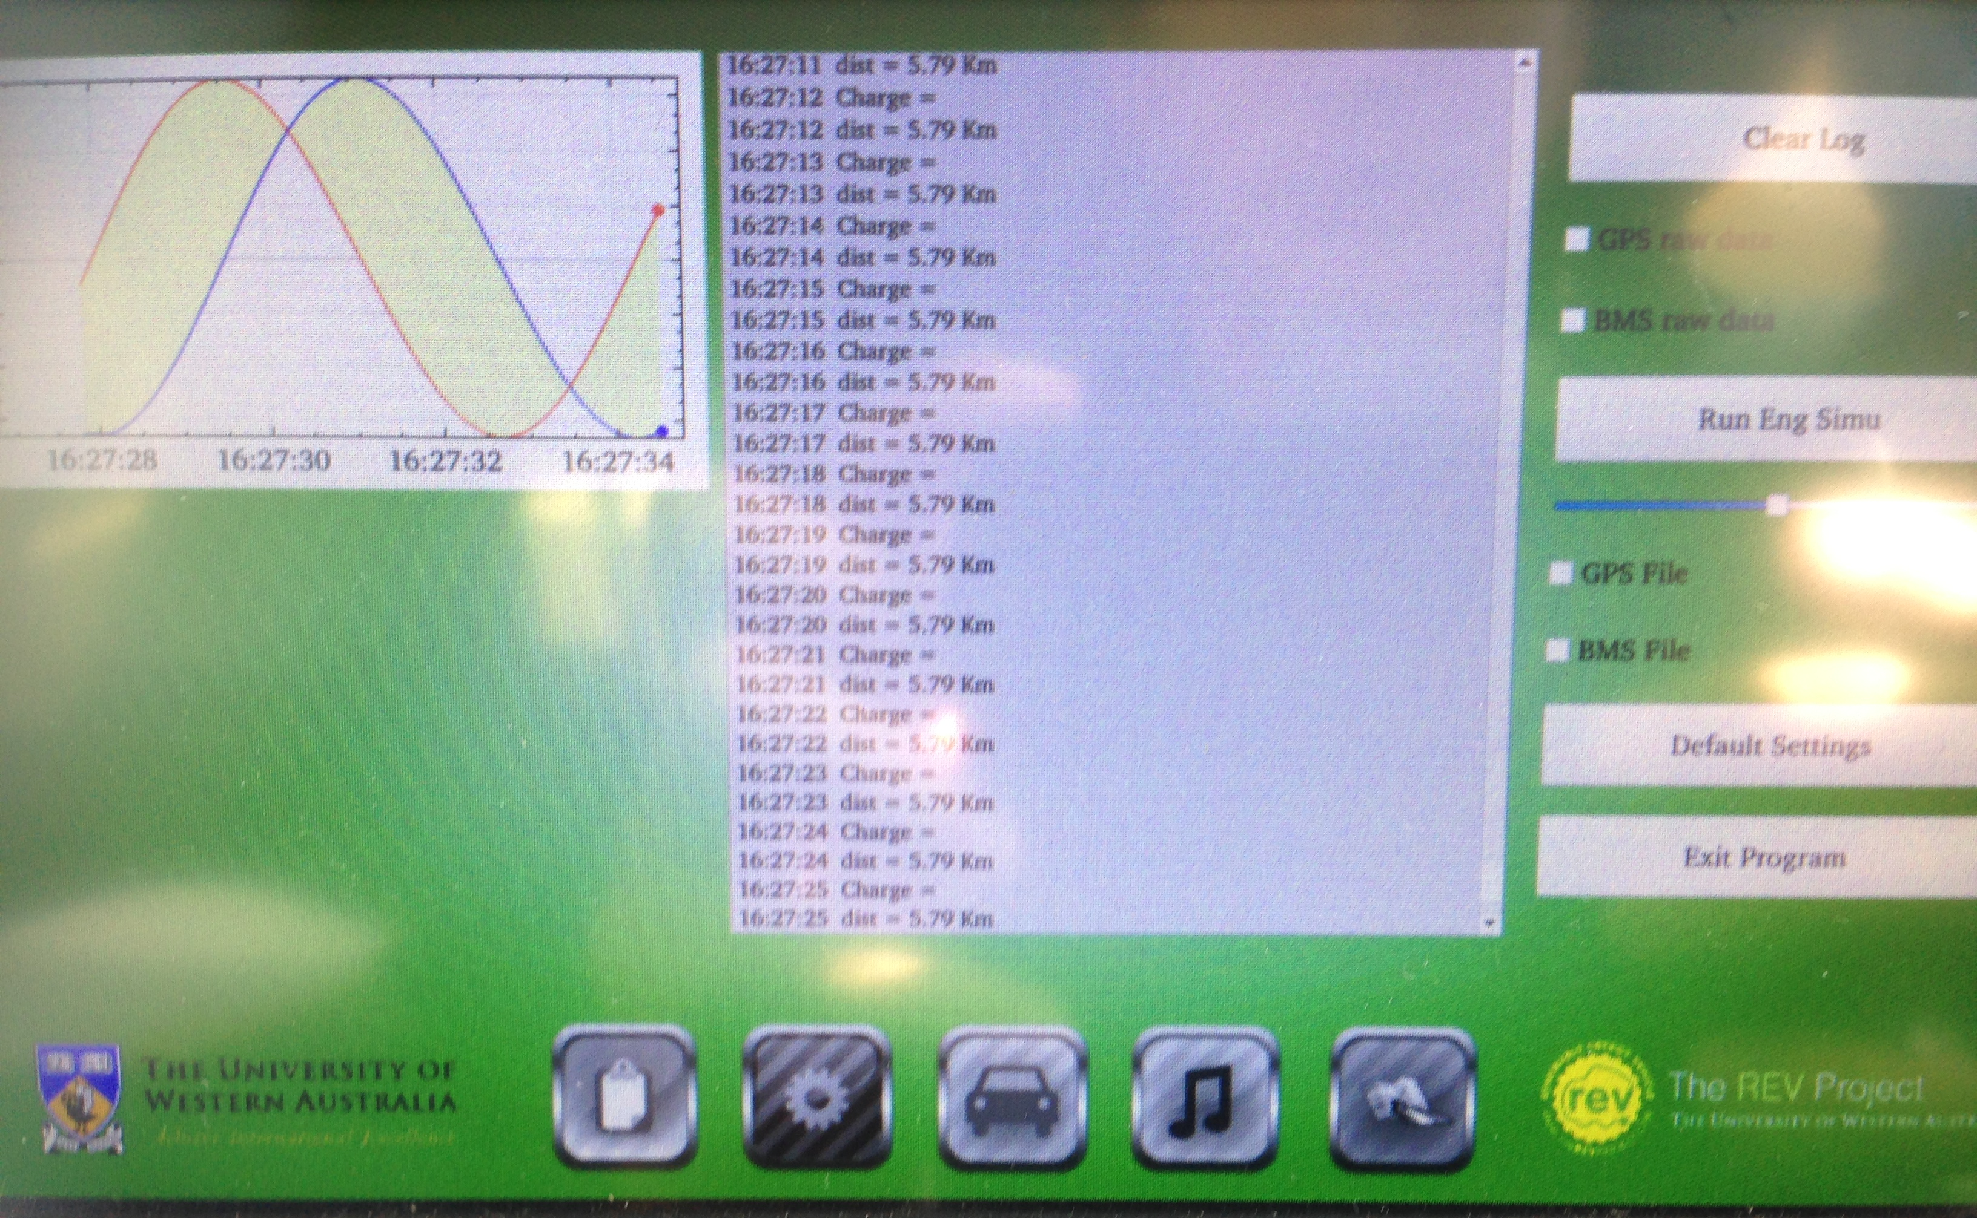
Logging
Notes:
This is the logging tab on the UI. This tab has not been modified much since the last UI, changes include the buttons at the bottom, smaller logging window and the graph as seen at the top left of the screen. This Is to display previous trip usage to enable drivers to track their driving habits and visually see if there are any improvements on their driving style.
Currently, the graph doesn’t show anything useful yet, only a dummy sine graph which shows some of the features that could be implemented in the graph later on.
Additionally, the space below the graph will also contain averages and statisics of previous trips.

Slide 13
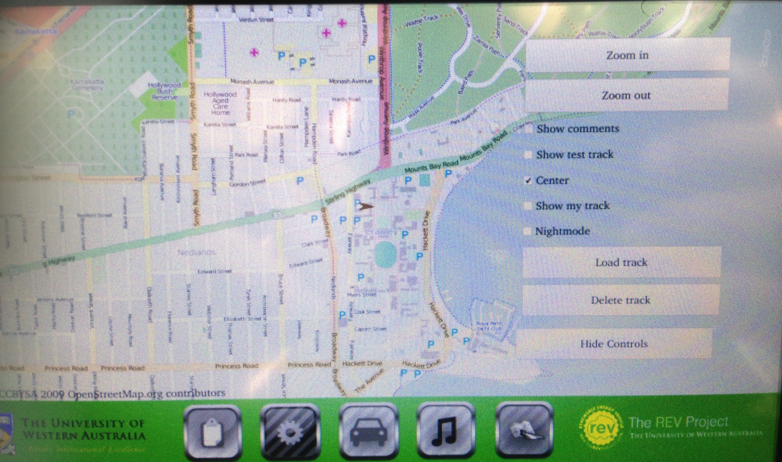
Maps/GPS
Notes:
This is the Maps tab as implemented in the GUI at the current moment. This is fully functional and enables users to track their current drive as well as loading saved test tracks to travel. Note the large GPS screen display and the ability to remove the hide the controls to view a larger map.
Again changes are mainly on the ability to change screens.

Slide 14
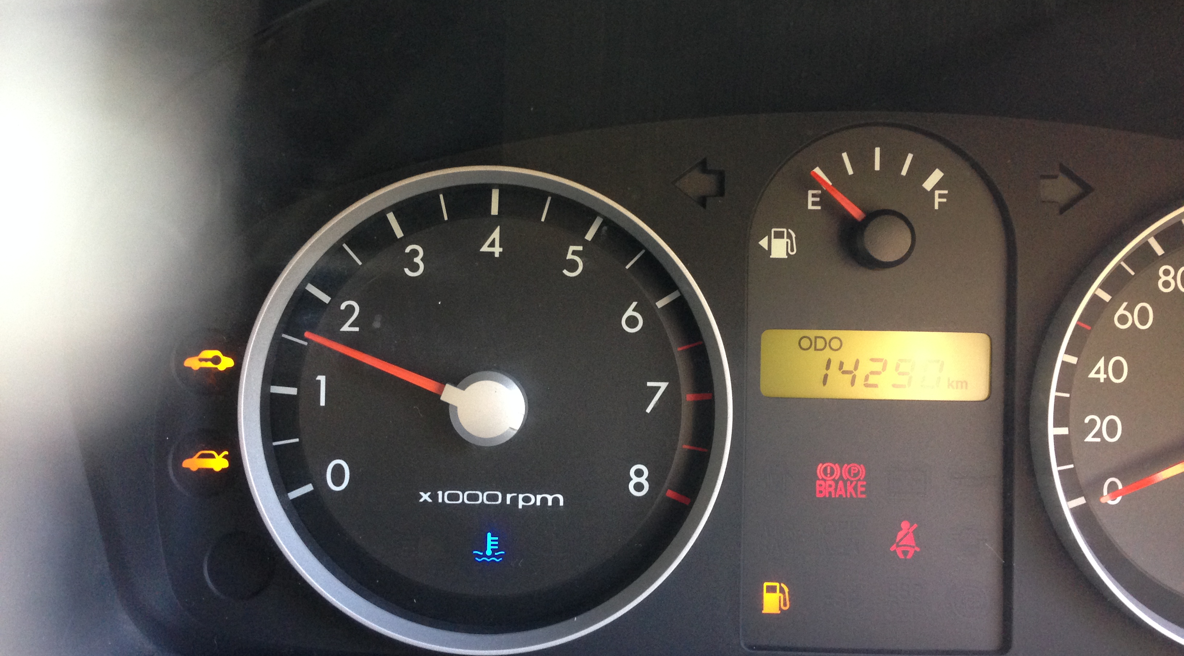
Tachometer
Implemented in REV Eco
Hall Effect Sensor
D Flip Flop
UQM Powerphase in Lotus
CANBUS
Notes:
The Tachometer in the REV Eco has been implemented and is now showing correct readings for the motor speed. This was done by connecting the Hall effect sensor from the motor to the original cluster. This was relatively easy as both the tachometer and the hall effect sensor provide and use PWM signals.
The tachometer in the Rev Racer is a more difficult task. The REV Racer uses a UQM Powerphase motor where the output is only trhough the serial CANBUS. Additioanlly, the original Lotus cluster doesn’t enable tachometer signals iva CANBUS, this was only updated in 2005 whereas the REV Racer was a 2002 model. However, this problem can be overcome by using the Rpi as a PWM wave generator to transmit to the cluster as it receives the corresponding signal from the motor. However this requires that the Rpi is able to take in digital inputs as well as digital outputs.

Slide 15
IO
Code inputs
Icons
PWM tachometer signal
Enable safe turn-off/on for Raspberry Pi
Serial CANBUS REV Racer
Notes:
The problem of inputs and outputs into the Raspberry Pi have been addressed. IO was required for a variety of reasons. These included the warning icons that were present on the home screen, to the working of the tachometer in the REV Racer to the implementation of EARS.
There were a variety of solutions to this issue, from using the current GPIO pins on the Rapsberyr Pi, to a Gertboard but the most appropriate solution was..

Slide 16
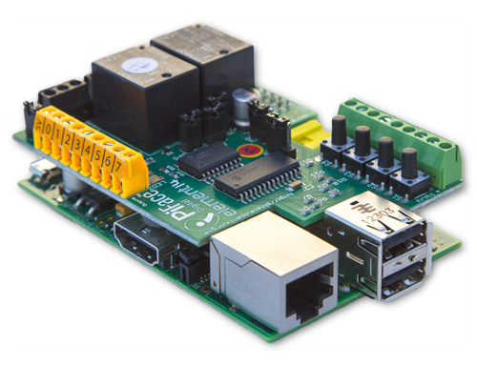
PiFace Digital
- ~$25 from Element 14
2 Changeover Relays
8 digital inputs
8 outputs
4 tactile switches
8 LED indicators
Notes:
The use of a simple expansion board on th eraspberry pi called PiFace Digital. This board was chosen as 1. the GPIO ports are very sensitive to voltage and it is very easy to burn a Rpi from sending an input that had too high a voltage (hihger than 3.3V). A Gertboard was also a solution, however they are expensive and also quite large.
PiFace seemed to be the obvious candidate to use due to its small size and cheap pricetag <$30. Additinally they provide 8 IO pins, with tactile buttons, which are useful for testing. Additionally, 2 relays are included on the board which would enable easy PWM wave generation. This was ideal for our application. The addition of this board also provides opportunity to add extra sensors in the future that can easily added using the screw terminals.
One downside of the PiFace is that the inputs cannot exceed 5V, whereas the car outputs signals at 12V which requires a voltage regulator circuit.

Slide 17
E.A.R.S.
EVs produce less noise <25km/h
Will implement after obtaining tachometer RPM signal into Raspberry Pi
Lost functionality from porting to Raspberry Pi
Now using ALSA library, a rudimentary system installed using current values, will connect to tachometer readings
REV Eco sound testing
Notes:
Electric cars produce significantly less noise in comparison with their ICE counterparts at low speeds, less than 25km/h. Once hihg speeds are attained, however, tyre noise contributes more significantly than engine noise.
As such, it is quite important in electric vehicles to implement a noise replicating system to improve safety around elctric vehicles, especially in low speed ocnditions like car parks.
With the ability to read in the tachometer/engine speed signals from the motors, it si now possible to implement EARS, the engine audio replicating system to emulate car sound. This has already been programmed but needs to be conencted to the engine speed signals to be effective.
Plans are to implement this is coming weeks.
Additionally, sound testing is planned to be done in the future to test the differences in sound coming from the REV Eco compared with a ICE Hyundai Getz.

Slide 18
Conclusion
Update of operating system and install of QT5 on the GUI
Addition of efficiency visual aids to encourage efficient driving behaviours implemented.
Tachometer has been implemented in the REV Eco
IO module have been programmed and installed, still has some bugs to fix

Slide 19
Upcoming/Future Work
Complete installation of IO module/PWM signal
Install GUI on REV Racer
E.A.R.S on both cars, improved version
Sound Testing in REV Eco
Possible upgrade to touchscreen in REV Eco
Notes:
Future work would include,

